Slide 1
IMS Health Big Data Experience Analyst

Slide 2



Introduction
Chapter 1

Slide 3
Chapter Topics
Introduction
About This Course
Course Logistics
Introductions

Slide 4
Course Objectives (1)
During this course, you will learn
The underlying technologies behind BigData Factory
Overview of IMS Health Hadoop setup
The purpose of Hadoop and its related tools
The features that Hive and Impala offer for data acquisition, storage, and analysis
How to identify typical use cases for large-scale data analysis
How to load data from relational databases and other sources
How to manage data in HDFS and export it for use with other systems
How Hive and Impala improve productivity for typical analysis tasks
The language syntax and data formats supported by these tools
How to design and execute queries on data stored in HDFS
How to join diverse datasets to gain valuable business insight

Slide 5
Course Objectives (2)
How to analyze structured, semi-structured, and unstructured data
How to store and query data for better performance
What Apache Spark is and why you would want to use it
The basic programming concepts of Spark: operations on Resilient Distributed Datasets (RDDs), Dataframes and optionally Datasets
How Spark works to distribute processing of big data across a cluster
How Spark interacts with other components of a big data system
How to take advantage of key Spark features to improve performance
How to use Spark – either interactively using a Spark Shell or by writing your own Spark Applications
How to use Spark SQL to work with structure data as tables
Git fundamentals, Nexus, sbt and Maven

Slide 6
Chapter Topics
Introduction
About This Course
Course Logistics
Introductions

Slide 7
Logistics
Class start and finish times
Lunch
Breaks
Restrooms
Virtual machines
Your instructor will give you details on how to access the course materials and exercise instructions for the class

Slide 8
Chapter Topics
Introduction
About This Course
Course Logistics
Introductions

Slide 9
Introductions
About your instructor
About you
Where do you work and what do you do there?
Which database(s) and platform(s) do you use?
Have you worked with Apache Hadoop or related tools?
Any experience as a developer?
– What programming languages do you use?
What are your expectations for this course?

Slide 10



Hadoop Fundamentals
Chapter 2

Slide 11
Hadoop Fundamentals
In this chapter, you will learn
Which factors led to the era of Big Data
What Hadoop is and what significant features it offers
How Hadoop offers reliable storage for massive amounts of data with HDFS
How Hadoop supports large-scale data processing through MapReduce
How ‘Hadoop Ecosystem’ tools can boost an analyst’s productivity
Several ways to integrate Hadoop into the modern data center

Slide 12
Chapter Topics
Hadoop Fundamentals
The Motivation for Hadoop
Hadoop Overview
Data Storage: HDFS
Distributed Data Processing: YARN, MapReduce, and Spark
Data Processing and Analysis: Pig, Hive, and Impala
Database Integration: Sqoop
Other Hadoop Data Tools
Exercise Scenario Explanation
Conclusion
Demo: Data Ingest with Hadoop Tools

Slide 13
Velocity
We are generating data faster than ever
Processes are increasingly automated
Systems are increasingly interconnected
People are increasingly interacting online

Slide 14
Variety
We are producing a wide variety of data
Social network connections
Server and application log files
Electronic medical records
Images, audio, and video
RFID and wireless sensor network events
Product ratings on shopping and review Web sites
And much more…
Not all of this maps cleanly to the relational model

Slide 15
Volume
Every day…
More than 1.5 billion shares are traded on the New York Stock Exchange
Facebook stores 2.7 billion comments and ‘Likes’
Google processes about 24 petabytes of data
Every minute…
Foursquare handles more than 2,000 check-ins
TransUnion makes nearly 70,000 updates to credit files
And every second…
Banks process more than 10,000 credit card transactions

Slide 16
Data Has Value
This data has many valuable applications
Product recommendations
Predicting demand
Marketing analysis
Fraud detection
And many, many more…
We must process it to extract that value
And processing all the data can yield more accurate results

Slide 17
We Need a System that Scales
We’re generating too much data to process with traditional tools
Two key problems to address
How can we reliably store large amounts of data at a reasonable cost?
How can we analyze all the data we have stored?

Slide 18
Chapter Topics
Hadoop Fundamentals
The Motivation for Hadoop
Hadoop Overview
Data Storage: HDFS
Distributed Data Processing: YARN, MapReduce, and Spark
Data Processing and Analysis: Pig, Hive, and Impala
Database Integration: Sqoop
Other Hadoop Data Tools
Exercise Scenario Explanation
Conclusion
Demo: Data Ingest with Hadoop Tools

Slide 19

What is Apache Hadoop?
Scalable and economical data storage and processing
Distributed and fault-tolerant
Harnesses the power of industry standard hardware
Heavily inspired by technical documents published by Google
Batch Processing (MapReduce, Hive, Pig)
Search Engine (Cloudera Search)
Machine Learning (Spark, Mahout)
Stream Processing (Spark)
Analytic SQL (Impala)
Other Applications
Workload Management (YARN) Data Storage
Filesystem (HDFS)
Online NoSQL (HBase)
Data Integration(Sqoop, Flume)
02-10

Slide 20
Scalability
Hadoop is a distributed system
A collection of servers running Hadoop software is called a cluster
Individual servers within a cluster are called nodes
Typically standard rackmount servers running Linux
Each node both stores and processes data
Add more nodes to the cluster to increase scalability
A cluster may contain up to several thousand nodes
You can scale out incrementally as required

Slide 21
Fault Tolerance
Paradox: Adding nodes increases the chance that any one of them will fail
Solution: build redundancy into the system and handle it automatically
Files loaded into HDFS are replicated across nodes in the cluster
If a node fails, its data is re-replicated using one of the other copies
Data processing jobs are broken into individual tasks
Each task takes a small amount of data as input
Thousands of tasks (or more) often run in parallel
If a node fails during processing, its tasks are rescheduled elsewhere
Routine failures are handled automatically without any loss of data

Slide 22
Chapter Topics
Hadoop Fundamentals
The Motivation for Hadoop
Hadoop Overview
Data Storage: HDFS
Distributed Data Processing: YARN, MapReduce, and Spark
Data Processing and Analysis: Pig, Hive, and Impala
Database Integration: Sqoop
Other Hadoop Data Tools
Exercise Scenario Explanation
Conclusion
Demo: Data Ingest with Hadoop Tools

Slide 23
HDFS: Hadoop Distributed File System
HDFS provides the storage layer for Hadoop data processing
Provides inexpensive and reliable storage for massive amounts of data
Other Hadoop components work with data in HDFS
– MapReduce, Impala, Hive, Pig, Spark, etc.
Batch Processing (MapReduce, Hive, Pig)
Search Engine (Cloudera Search)
Machine Learning (Spark, Mahout)
Stream Processing (Spark)
Analytic SQL (Impala)
Other Applications
Workload Management (YARN) Data Storage
Filesystem (HDFS)
Online NoSQL (HBase)
Data Integration(Sqoop, Flume)

Slide 24
HDFS Features
Optimized for sequential access to a relatively small number of large files
Each file is likely to be 100MB or larger
Multi-gigabyte files are typical
In some ways, HDFS is similar to a UNIX filesystem
Hierarchical, with UNIX-style paths (e.g., /sales/rpt/asia.txt)
UNIX-style file ownership and permissions
There are also some major deviations from UNIX
No concept of a current directory
Cannot modify files once written
Must use Hadoop-specific utilities or custom code to access HDFS

Slide 25




HDFS Architecture
Hadoop has a master/slave architecture
HDFS master daemon: NameNode
Manages namespace and metadata
Monitors slave nodes
HDFS slave daemon: DataNode
Reads and writes the actual data
A Small Hadoop Cluster
Master
HDFS master daemon
Slaves
HDFS slave daemons

Slide 26


Accessing HDFS via the Command Line
HDFS is not a general purpose filesystem
Not built into the OS, so only specialized tools can access it
End users typically access HDFS via the hdfs dfs command
Example: display the contents of the /user/fred/sales.txt file
$ hdfs dfs -cat /user/fred/sales.txt
Example: Create a directory (below the root) called reports
$ hdfs dfs -mkdir /reports

Slide 27


Copying Local Data To and From HDFS
Remember that HDFS is distinct from your local filesystem
– Use hdfs | dfs | –put to copy local files to HDFS
– Use hdfs | dfs | -get to fetch a local copy of a file from HDFS
Hadoop Cluster
$ hdfs dfs -put file
Client
$ hdfs dfs -get file

Slide 28



More hdfs
dfs Command Examples
Copy file input.txt from local disk to the user’s directory in HDFS
$ hdfs dfs -put input.txt input.txt
– This will copy the file to /user/username/input.txt
Get a directory listing of the HDFS root directory
$ hdfs dfs -ls /
Delete the file /reports/sales.txt
$ hdfs dfs -rm /reports/sales.txt

Slide 29


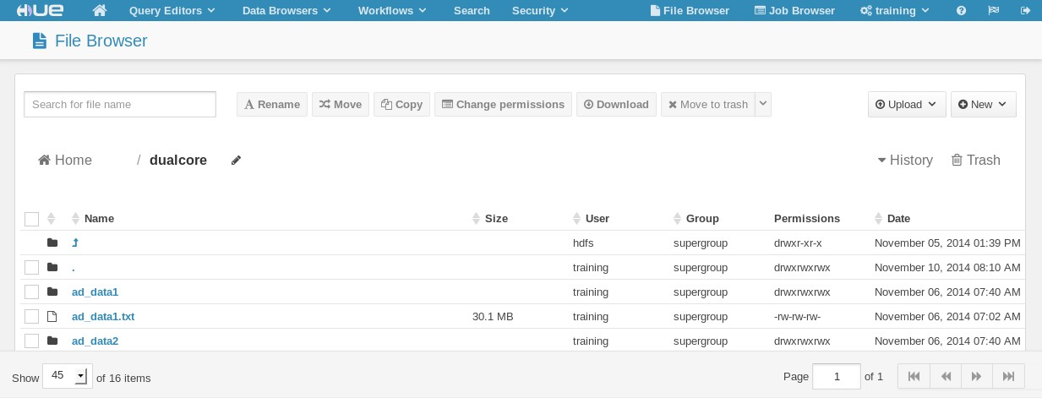









Using the Hue HDFS File Manager
Hue is a Web interface for Hadoop
Hadoop User Experience
Hue includes an application for browsing and managing files in HDFS
To use Hue, browse to http://hue_server:8888/
Manage Files
Upload Files
Browse Files
02-20

Slide 30
Chapter Topics
Hadoop Fundamentals
The Motivation for Hadoop
Hadoop Overview
Data Storage: HDFS
Distributed Data Processing: YARN, MapReduce, and Spark
Data Processing and Analysis: Pig, Hive, and Impala
Database Integration: Sqoop
Other Hadoop Data Tools
Exercise Scenario Explanation
Conclusion
Demo: Data Ingest with Hadoop Tools

Slide 31
Workload Management: YARN
Many Hadoop tools work with data in a Hadoop cluster
Requires workload management to distribute and monitor work across the cluster
Batch Processing (MapReduce, Hive, Pig)
Search Engine (Cloudera Search)
Machine Learning (Spark, Mahout)
Stream Processing (Spark)
Analytic SQL (Impala)
Other Applications
Workload Management (YARN or MapReduce 1) Data Storage
Filesystem (HDFS)
Online NoSQL (HBase)
Data Integration(Sqoop, Flume)

Slide 32
Hadoop Cluster Architecture
Master/Slave Architecture
YARN or MapReduce version 1
– Details differ slightly
Master nodes
Run master daemons to accept jobs, and monitor and distribute work
Slave nodes
Run slave daemons to start tasks
Do the actual work
Report status back to master daemons
HDFS and YARN/MRv1 are collocated
Slave nodes run both HDFS and slave daemons on the same machines
A Small Hadoop Cluster
Master
YARN master daemon
HDFS master daemon
Slaves
YARN slave daemons
HDFS slave daemons

Slide 33
General Data Processing
Hadoop includes two general data processing engines
MapReduce
Spark
Both are programming libraries (Java, Scala, Python…)
Batch Processing (MapReduce, Hive, Pig)
Search Engine (Cloudera Search)
Machine Learning (Spark, Mahout)
Stream Processing (Spark)
Analytic SQL (Impala)
Other Applications
Workload Management (YARN or MapReduce) Data Storage
Filesystem (HDFS)
Online NoSQL (HBase)
Data Integration(Sqoop, Flume)

Slide 34
Hadoop MapReduce
Hadoop MapReduce was the original processing engine for Hadoop
Still the most commonly used general data processing engine
Based on the the ‘map-reduce’ programming model
A style of processing data popularized by Google
Provides a set of programming libraries
Primarily supports Java
Streaming MapReduce provides (limited) support for scripting languages such as Python
Benefits of Hadoop MapReduce
Simplicity
Flexibility
Scalability

Slide 35
Apache Spark
The next generation general data processing engine
Builds on the same ‘map-reduce’ programming model as Hadoop MapReduce
Originally developed at AMP Lab at UC Berkeley
Spark supports Scala, Java, and Python
Spark has the same benefits as MapReduce, plus…
Improved performance using in-memory processing
Higher level programming model to speed up development

Slide 36
Chapter Topics
Hadoop Fundamentals
The Motivation for Hadoop
Hadoop Overview
Data Storage: HDFS
Distributed Data Processing: YARN, MapReduce, and Spark
Data Analysis and Processing: Pig, Hive, and Impala
Database Integration: Sqoop
Other Hadoop Data Tools
Exercise Scenario Explanation
Conclusion
Demo: Data Ingest with Hadoop Tools

Slide 37
Data Processing and Analysis with Hadoop (1)
Hadoop MapReduce and Spark are powerful data processing engines but…
Hard to master
Require programming skills
Slow to develop, hard to maintain
Hadoop includes several other tools for data processing and analysis
Tools for data analysts, not programmers

Slide 38














Data Processing and Analysis with Hadoop (2)
Higher level abstractions for general data processing
Pig, Hive
Specialized processing engines for interactive analysis
Impala, Search
PigLatin
Impala/HiveQL
Natural Language
Data Platform
Impala
Search
Pig
Hive
Data Processing Engine
MapReduce, Spark, etc.
Data Storage
HDFS

Slide 39



Apache Pig
Apache Pig builds on Hadoop to offer high-level data processing
This is an alternative to writing low-level MapReduce code
Pig is especially good at joining and transforming data
people = orders = cost); groups = totals = result =
LOAD '/user/training/customers' AS (cust_id, name); LOAD '/user/training/orders' AS (ord_id, cust_id,
GROUP orders BY cust_id;
FOREACH groups GENERATE group, SUM(orders.cost) AS t; JOIN totals BY group, people BY cust_id;
DUMP result;
The Pig interpreter runs on the client machine
Turns PigLatin scripts into MapReduce jobs
Submits those jobs to the cluster
02-30

Slide 40


Apache Hive
Hive is another abstraction on top of Hadoop
Like Pig, it also reduces development time
Hive uses a SQL-like language called HiveQL
SELECT customers.cust_id, SUM(cost) AS total FROM customers
JOIN orders
ON (customers.cust_id = orders.cust_id) GROUP BY customers.cust_id
ORDER BY total DESC;
A Hive Server runs on a master node
Turns HiveQL queries into MapReduce jobs
Submits those jobs to the cluster

Slide 41

Cloudera Impala
Massively parallel SQL engine which runs on a Hadoop cluster
Inspired by Google’s Dremel project
Can query data stored in HDFS or HBase tables
Uses Impala SQL
Very similar to HiveQL
High performance
Typically at least 10 times faster than Hive or MapReduce
High-level query language (subset of SQL-92)
Impala is 100% Apache-licensed open source

Slide 42
Chapter Topics
Hadoop Fundamentals
The Motivation for Hadoop
Hadoop Overview
Data Storage: HDFS
Distributed Data Processing: YARN, MapReduce, and Spark
Data Processing and Analysis: Pig, Hive, and Impala
Database Integration: Sqoop
Other Hadoop Data Tools
Exercise Scenario Explanation
Conclusion
Demo: Data Ingest with Hadoop Tools

Slide 43
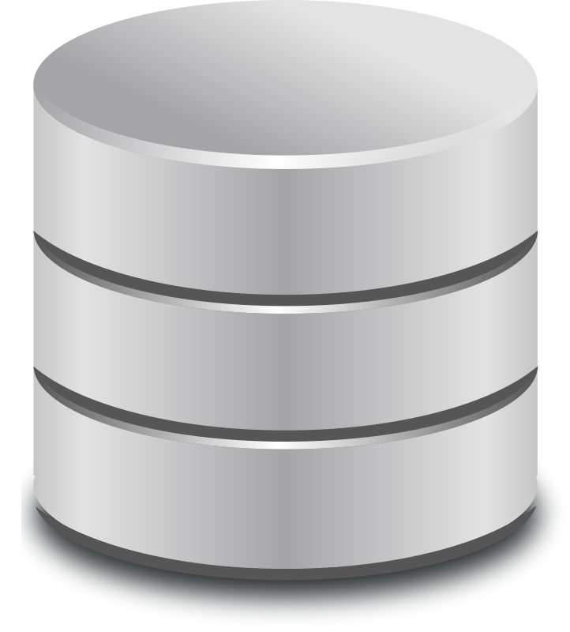


Apache Sqoop
Sqoop exchanges data between an RDBMS and Hadoop
It can import all tables, a single table, or a portion of a table into HDFS
Does this very efficiently via a Map-only MapReduce job
Result is a directory in HDFS containing comma-delimited text files
Sqoop can also export data from HDFS back to the database
Database Hadoop Cluster

Slide 44

Importing Tables with Sqoop
This example imports the customers table from a MySQL database
Will create /mydata/customers directory in HDFS
Directory will contain comma-delimited text files
$ sqoop import \
--connect jdbc:mysql://localhost/company \
--username twheeler --password bigsecret \
--warehouse-dir /mydata \
--table customers
Adding the --direct option may offer better performance
Uses database-specific tools instead of JDBC
This option is not compatible with all databases
High-performance custom connectors for some databases
Netezza, Teradata, MySQL…

Slide 45


Importing An Entire Database with Sqoop
Import all tables from the database (fields will be tab-delimited)
$ sqoop import-all-tables \
--connect jdbc:mysql://localhost/company \
--username twheeler --password bigsecret \
--fields-terminated-by '\t' \
--warehouse-dir /mydata

Slide 46


Importing Partial Tables with Sqoop
Import only specified columns from products table
$ sqoop import \
--connect jdbc:mysql://localhost/company \
--username twheeler --password bigsecret \
--warehouse-dir /mydata \
--table products \
--columns "prod_id,name,price"
Import only matching rows from products table
$ sqoop import \
--connect jdbc:mysql://localhost/company \
--username twheeler --password bigsecret \
--warehouse-dir /mydata \
--table products \
--where "price >= 1000"

Slide 47

Incremental Imports with Sqoop
What if new records are added to the database?
Could re-import all records, but this is inefficient
Sqoop’s incremental append mode imports only new records
Based on value of last record in specified column
$ sqoop import \
--connect jdbc:mysql://localhost/company \
--username twheeler --password bigsecret \
--warehouse-dir /mydata \
--table orders \
--incremental append \
--check-column order_id \
--last-value 6713821

Slide 48
Handling Modificationswith Incremental Imports
What if existing records are also modified in the database?
Incremental append mode doesn’t handle this
In CDH 5.2 and later, Sqoop’s lastmodified append mode adds and
updates records
Caveat: You must maintain a timestamp column in your table
$ sqoop import \
--connect jdbc:mysql://localhost/company \
--username twheeler --password bigsecret \
--warehouse-dir /mydata \
--table shipments \
--incremental lastmodified \
--check-column last_update_date \
--last-value "2013-06-12 03:15:59"

Slide 49
Exporting Data from Hadoop to RDBMS with Sqoop
We have seen several ways to pull records from an RDBMS into Hadoop
– It is sometimes also helpful to push data in Hadoop back to an RDBMS
Sqoop supports this via export
$ sqoop export \
--connect jdbc:mysql://localhost/company \
--username twheeler --password bigsecret \
--export-dir /mydata/recommender_output \
--table product_recommendations
02-40

Slide 50
Chapter Topics
Hadoop Fundamentals
The Motivation for Hadoop
Hadoop Overview
Data Storage: HDFS
Distributed Data Processing: YARN, MapReduce, and Spark
Data Processing and Analysis: Pig, Hive, and Impala
Database Integration: Sqoop
Other Hadoop Data Tools
Exercise Scenario Explanation
Conclusion
Demo: Data Ingest with Hadoop Tools

Slide 51

Apache HBase
HBase is “the Hadoop database”
Can store massive amounts of data
Gigabytes, terabytes, and even petabytes of data in a table
Tables can have many thousands of columns
Scales to provide very high write throughput
Hundreds of thousands of inserts per second
Fairly primitive when compared to an RDBMS
NoSQL : There is no high-level query language
Use API to scan / get / put values based on keys

Slide 52






Apache Flume
Flume imports data into HDFS as it is being generated by various sources
Log Files
UNIX
syslog
Custom Sources
Program Output
And many more...
Hadoop Cluster

Slide 53
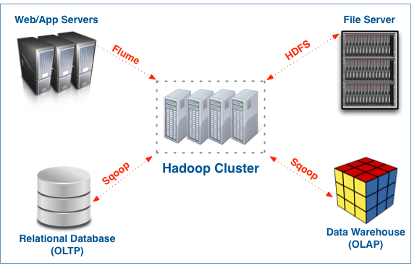
Recap: Data Center Integration

Slide 54
IMS Health Environment
Development/UACC cluster (Spark 1.5.1)
8 data nodes (16Tb each -> 128Tb of space)
3 management nodes (8Tb of disk space each)
Results in heterogenious cluster
Production cluster (Spark 1.6.x)
35 nodes to be upgraded to 50-60 nodes
Current production to be moved to Dev/UACC
Supplier group + HSI initiative
Administered by DBA group
Using Cloudera manager to administer clusters
Hive and Impala

Slide 55
IMS Health Environment
Edge node
Hive shell
Impala shell
Spark shell
Spark-submit
HBase
Java API
Server component
REST API
Real time processing

Slide 56
Chapter Topics
Hadoop Fundamentals
The Motivation for Hadoop
Hadoop Overview
Data Storage: HDFS
Distributed Data Processing: YARN, MapReduce, and Spark
Data Processing and Analysis: Pig, Hive, and Impala
Database Integration: Sqoop
Other Hadoop Data Tools
Exercise Scenario Explanation
Conclusion
Demo: Data Ingest with Hadoop Tools

Slide 57
Hands-On Exercises: Scenario Explanation
Hands-On Exercises throughout the course will reinforce the topics being discussed
Exercises simulate the kind of tasks often performed using the tools you will learn about in class
Most exercises depend on data generated in earlier exercises
Scenario: Dualcore Inc. is a leading electronics retailer
More than 1,000 brick-and-mortar stores
Dualcore also has a thriving e-commerce Web site
Dualcore has hired you to help find value in its data
You will process and analyze data from internal and external sources
Identify opportunities to increase revenue
Find new ways to reduce costs
Help other departments achieve their goals

Slide 58
Chapter Topics
Hadoop Fundamentals
The Motivation for Hadoop
Hadoop Overview
Data Storage: HDFS
Distributed Data Processing: YARN, MapReduce, and Spark
Data Processing and Analysis: Pig, Hive, and Impala
Database Integration: Sqoop
Other Hadoop Data Tools
Exercise Scenario Explanation
Conclusion
Demo: Data Ingest with Hadoop Tools

Slide 59
Essential Points
We are generating more data – and faster – than ever before
Most of this data maps poorly to structured relational tables
The ability to store and process this data can yield valuable insight
Hadoop offers scalable data storage and processing
There are lots of tools in the Hadoop ecosystem that help you to integrate Hadoop with other systems, manage complex jobs, and ease analysis

Slide 60
Bibliography
The following offer more information on topics discussed in this chapter
10 Hadoopable Problems (recorded presentation)
http://tiny.cloudera.com/dac02a
Guide to HDFS Commands
http://tiny.cloudera.com/hdfscommands
Hadoop: The Definitive Guide, 3rd Edition (O’Reilly book)
http://tiny.cloudera.com/hadooptdg
Sqoop User Guide
http://tiny.cloudera.com/sqoopuser
Spark Documentation
http://tiny.cloudera.com/sparkdoc

Slide 61
Chapter Topics
Hadoop Fundamentals
The Motivation for Hadoop
Hadoop Overview
Data Storage: HDFS
Distributed Data Processing: YARN, MapReduce, and Spark
Data Processing and Analysis: Pig, Hive, and Impala
Database Integration: Sqoop
Other Hadoop Data Tools
Exercise Scenario Explanation
Conclusion
Exercise: Data Ingest with Hadoop Tools
02-50

Slide 62
About the Training Virtual Machine
During this course, you will perform numerous hands-on exercises using the Cloudera Training Virtual Machine (VM)
The VM has Hadoop installed in pseudo-distributedmode
A cluster comprised of a single node
Typically used for testing code before deploying to a large cluster

Slide 63
Demo: Data Ingest with Hadoop Tools
In this Demo, you will gain practice adding data from the local filesystem and a relational database server to HDFS
– You will analyze this data in subsequent exercises
Please refer to the Hands-On Exercise Manual for instructions

Slide 64
Introduction to Impala and Hive
Chapter 3

Slide 65
Introduction to Impala and Hive
In this chapter, you will learn
What Hive is
What Impala is
How Hive and Impala differ from a relational database
Ways in which organizations use Hive and Impala
03-2

Slide 66

Review: Hadoop Data Processing and Analysis
Hadoop includes many tools for data processing and analysis
PigLatin
Impala/HiveQL
Natural Language
Data Platform
Impala
Search
Pig
Hive
Data Processing Engine
MapReduce, Spark, etc.
Data Storage
HDFS

Slide 67
Chapter Topics
Introduction to Impala and Hive
What is Hive?
What is Impala?
Schema and Data Storage
Comparing Hive to Traditional Databases
Hive Use Cases
Conclusion

Slide 68
What is Apache Hive?
Apache Hive is a high-level abstraction on top of MapReduce
Uses a SQL-like language called HiveQL
Generates jobs that run on the Hadoop cluster
Originally developed by Facebook for data warehousing
– Now an open-source Apache project

Slide 69



HiveQL
HiveQL implements a subset of SQL-92
– Plus a few extensions found in MySQL and Oracle SQL dialects
SELECT zipcode, SUM(cost) AS total FROM customers
JOIN orders
ON (customers.cust_id = orders.cust_id) WHERE zipcode LIKE '63%'
GROUP BY zipcode ORDER BY total DESC;
HiveQL
SQL -92

Slide 70







Hive High-Level Overview
Hive
Turns HiveQL queries into data processing jobs
Submits those jobs to the data processing engine (MapReduce) to execute on the cluster
SELECT zipcode, SUM(cost) AS total FROM customers
JOIN orders
ON (customers.cust_id = orders.cust_id)
WHERE zipcode LIKE '63%' GROUP BY zipcode
ORDER BY total DESC;
Parse HiveQL
Make optimizations
Plan execution
Submit job(s) to cluster
Monitor progress
Data Processing Engine
Hadoop Cluster
HDFS

Slide 71
Chapter Topics
Introduction to Impala and Hive
What is Hive?
What is Impala?
Schema and Data Storage
Comparing Hive to Traditional Databases
Hive Use Cases
Conclusion

Slide 72
What is Impala?
Impala is a high-performance SQL engine for vast amounts of data
Massively-parallel processing (MPP)
Inspired by Google’s Dremel project
Query latency measured in milliseconds
Impala runs on Hadoop clusters
Can query data stored in HDFS or HBase tables
Reads and writes data in common Hadoop file formats
Developed by Cloudera
100% open source, released under the Apache software license

Slide 73

Impala High-Level Overview
Impala
Executes Impala SQL queries directly on the Hadoop Cluster
Does not rely on a general- purpose data processing engine such as MapReduce
Highly-optimized for queries
Almost always at least five times faster than either Hive or Pig
– Often 20 times faster or more
SELECT zipcode, SUM(cost) AS total FROM customers
JOIN orders
ON (customers.cust_id = orders.cust_id)
WHERE zipcode LIKE '63%' GROUP BY zipcode
ORDER BY total DESC;
Parse Impala Query Lang
Make optimizations
Plan execution
Execute query on the cluster
Hadoop Cluster
HDFS
03-10

Slide 74



Impala Query Language
Impala supports a subset of HiveQL
– Plus a few additionalcommands
Impala
HiveQL
SQL -92

Slide 75
Why Use Hive and Impala?
More productive than writing MapReduce directly
Five lines of HiveQL/Impala SQL might be equivalent to 200 lines or more of Java
Brings large-scale data analysis to a broader audience
No software development experience required
Leverage existing knowledge of SQL
Offers interoperability with other systems
Extensible through Java and external scripts
Many business intelligence (BI) tools support Hive and/or Impala

Slide 76
Comparing Hive and Impala
Hive and Impala are different tools, but are closely related
Both use very similar variants of SQL
Both share the same data warehouse and metadatastorage
They are often used together
The next few chapters focus on the areas that are the same between Hive and Impala
HiveQL and Impala SQL are nearly identical
Minor differences will be noted
Later chapters will focus on the areas in which they differ

Slide 77
Where to Get Hive and Impala
CDH is the easiest way to install Hadoop, Hive and Impala
A Hadoop distribution which includes HDFS, MapReduce, Spark, Pig, Hive, Impala, Sqoop, HBase, and other Hadoop ecosystem components
Available as RPMs, Ubuntu/Debian/SuSE packages, or a tarball
Simple installation
100% free and open source
Installation is outside the scope of this course

Slide 78
Chapter Topics
Introduction to Impala and Hive
What is Hive?
What is Impala?
Schema and Data Storage
Comparing Hive and Impala to Traditional Databases
Hive and Impala Use Cases
Conclusion

Slide 79
How Hive and Impala Load and Store Data (1)
Queries operate on tables, just like in an RDBMS
A table is simply an HDFS directory containing one or more files
Default path: /user/hive/warehouse/<table_name>
Supports many formats for data storage and retrieval
What is the structure and location of tables?
These are specified when tables are created
This metadata is stored in the Metastore
– Contained in an RDBMS such as MySQL
Hive and Impala work with the same data
Tables in HDFS, metadata in the Metastore

Slide 80









How Hive and Impala Load and Store Data (2)
Hive and Impala use the Metastore to determine data format and location
– The query itself operates on data stored on a filesystem (typically HDFS)
Metastore
(metadata in RDBMS)
Query
Impala or Hive Server
Tables
(data in HDFS files)

Slide 81
Chapter Topics
Introduction to Impala and Hive
What is Hive?
What is Impala?
Schema and Data Storage
Comparing Hive and Impala to Traditional Databases
Hive and Impala Use Cases
Conclusion

Slide 82
Your Cluster is Not a Database Server
Client-server database management systems have many strengths
Very fast response time
Support for transactions
Allow modification of existing records
Can serve thousands of simultaneous clients
Your Hadoop cluster is not an RDBMS
Hive generates processing engine jobs (MapReduce) from HiveQL queries
– Limitations of HDFS and MapReduce still apply
Impala is faster but not intended for the throughput speed required for an OLTP database
No transaction support

Slide 83
Comparing Hive and Impala To A Relational Database
Relational Database Hive Impala
Query language | SQL (full) | SQL (subset) | SQL (subset)
Update individual records | Yes | No | No
Delete individual records | Yes | No | No
Transactions | Yes | No | No
Index support | Extensive | Limited | No
Latency | Very low | High | Low
Data size | Terabytes | Petabytes | Petabytes
03-20

Slide 84
Chapter Topics
Introduction to Impala and Hive
What is Hive?
What is Impala?
Schema and Data Storage
Comparing Hive and Impala to Traditional Databases
Hive and Impala Use Cases
Conclusion

Slide 85












Use Case: Log File Analytics
Server log files are an important source of data
Hive and Impala allow you to treat a directory of log files like a table
– Allows SQL-like queries against raw data
Dualcore Inc. Public Web Site (June 1 - 8)
Product | Unique Visitors | Page Views | Average Time on Page | Bounce Rate | Conversion Rate
Tablet | 5,278 | 5,894 | 17 seconds | 23% | 65%
Notebook | 4,139 | 4,375 | 23 seconds | 47% | 31%
Stereo | 2,873 | 2,981 | 42 seconds | 61% | 12%
Monitor | 1,749 | 1,862 | 26 seconds | 74% | 19%
Router | 987 | 1,139 | 37 seconds | 56% | 17%
Server | 314 | 504 | 53 seconds | 48% | 28%
Printer | 86 | 97 | 34 seconds | 27% | 64%

Slide 86




















Use Case: Sentiment Analysis
Many organizations use Hive or Impala to analyze social media coverage
Mentions of Dualcore on Social Media (by Hour)
Negative Neutral Positive
07 08 09 10 11 12 13 14 15 16 17 18

Slide 87


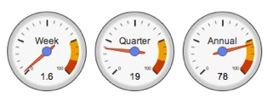
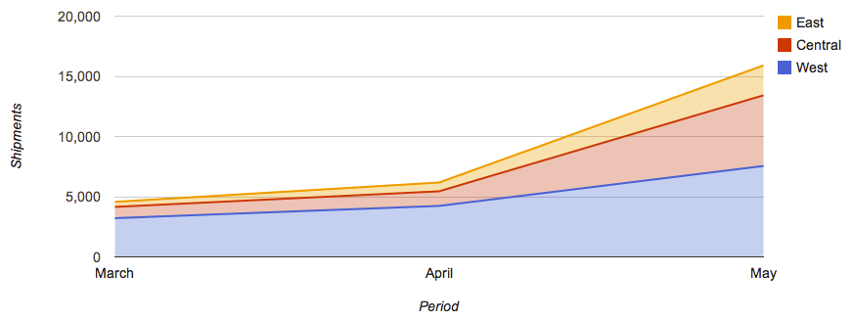

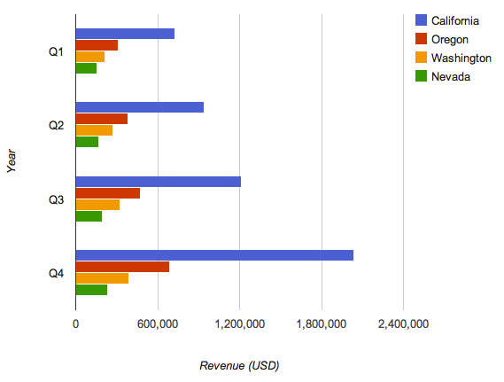

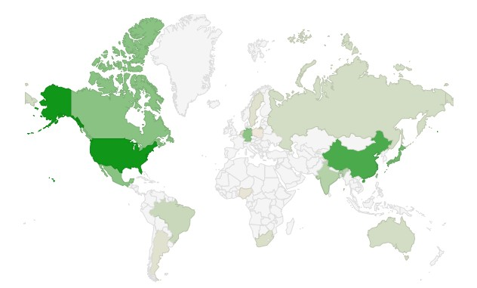


Use Case: Business Intelligence
Many leading business intelligence tools support Hive and Impala
Dualcore Inc. Dashboard
https://dashboard.example.com/
Google
Revenue by Period
Order Shipments Per Month
Top States for In-Store Sales
Suppliers by Region
Japan: 31 suppliers

Slide 88
Chapter Topics
Introduction to Impala and Hive
What is Hive?
What is Impala?
Schema and Data Storage
Comparing Hive and Impala to Traditional Databases
Hive and Impala Use Cases
Conclusion

Slide 89
Essential Points
Impala and Hive are tools for performing SQL queries on data in HDFS
HiveQL and Impala SQL are very similar to SQL-92
Easy to learn for those with relational database experience
However, does not replace your RDBMS
Hive generates jobs that run on the Hadoop cluster data processing engine
Runs MapReduce jobs on Hadoop based on HiveQL statements
Impala execute queries directly on the Hadoop cluster
Uses a very fast specialized SQL engine, not MapReduce
Tables are really directories of files in HDFS
Information about those tables is kept in the Metastore (in an RDBMS)

Slide 90
Bibliography
The following offer more information on topics discussed in this chapter
Cloudera Impala (free O’Reilly book)
http://tiny.cloudera.com/impalabook
Programming Hive (O’Reilly book)
http://tiny.cloudera.com/programminghive
Data Analysis with Hadoop and Hive at Orbitz
http://tiny.cloudera.com/dac09b
Sentiment Analysis Using Apache Hive
http://tiny.cloudera.com/dac09c
Wired Article on Impala
http://tiny.cloudera.com/wiredimpala

